Slide 1

Create Ansible role

Slide 2

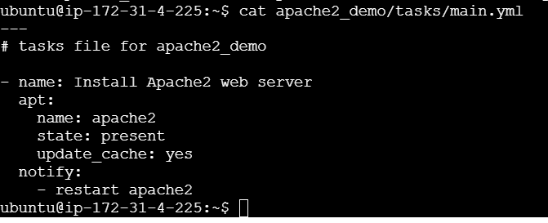


code

Slide 3
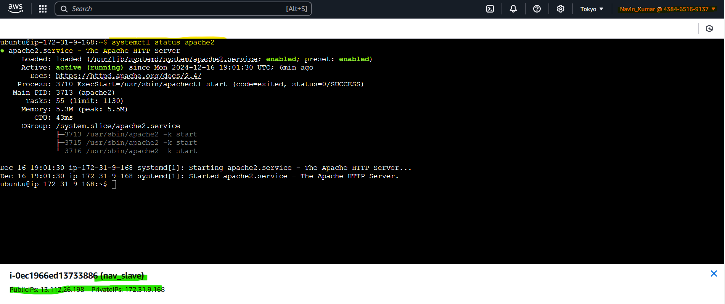

Slide 4
